Slide 1

Department Of Electrical Engineering
Project :
DESIGN OF BIDIRECTIONAL CONVERTER FOR ELECTRIC VEHICLE CHARGING STATION
Group members:
Ashutosh Prakash (180914)
Atul Pandey(180915)
Siddharth Sharma(180942)
Project Guide:
Dr. Munish Manas

Slide 2
Table Of Content
Control Mechanism Of Inverter
Control Of Bidirectional Converter
Result
Future Work
Conclusion
Reference
What is Vehicle to Grid ?
Chargers Topology
Levels Of Charging
Simulation Scheme
Transformation
Phase locked loop

Slide 3
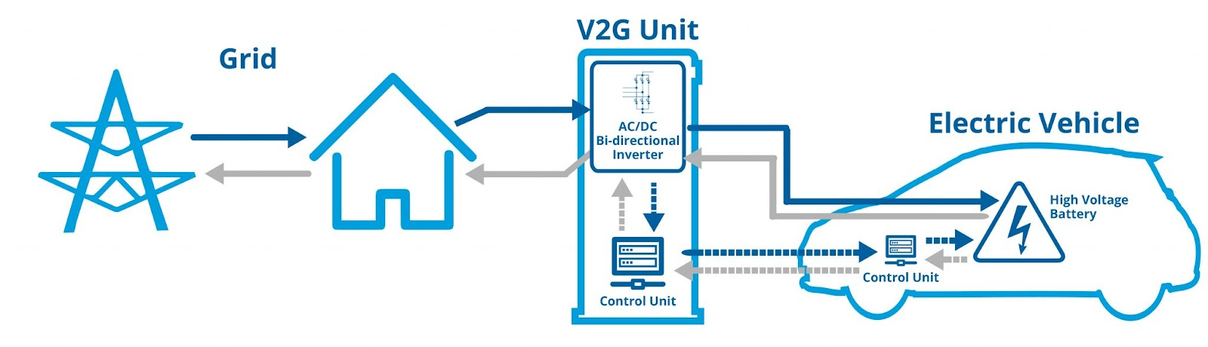
What is Vehicle to Grid ?
This is a technology that involves the use of a car as a kind of capacity for storing electricity.
Numerous studies have shown that the vast majority of personal cars are not used 95% of their time.

Slide 4
CHARGERS TOPOLOGY
Types Of Chargers
1) Uni-directional charger and Bi-directional charger
2) On-board charger and off-board charger
3) Conductive charges and Inductive charges

Slide 5
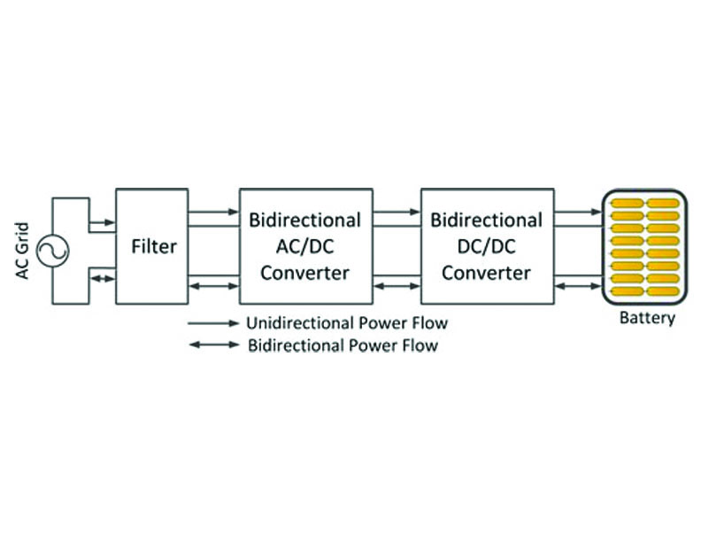
Uni-directional charger and Bi-directional charger

Slide 6
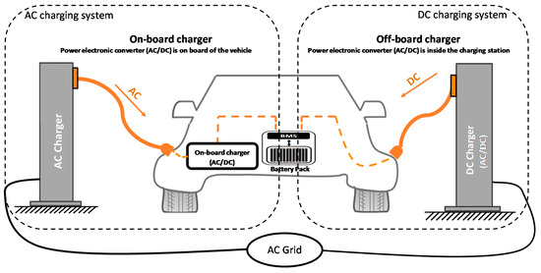
On-board charger and off-board charger

Slide 7
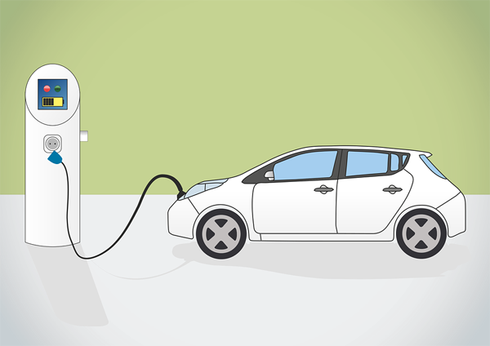
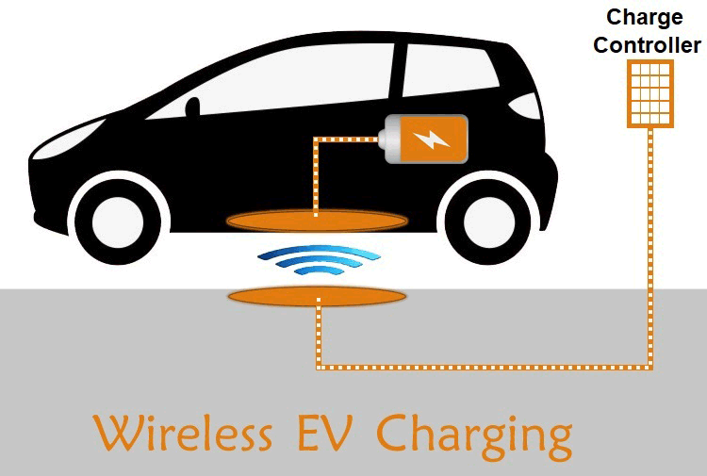
Conductive charges
Inductive charges

Slide 8
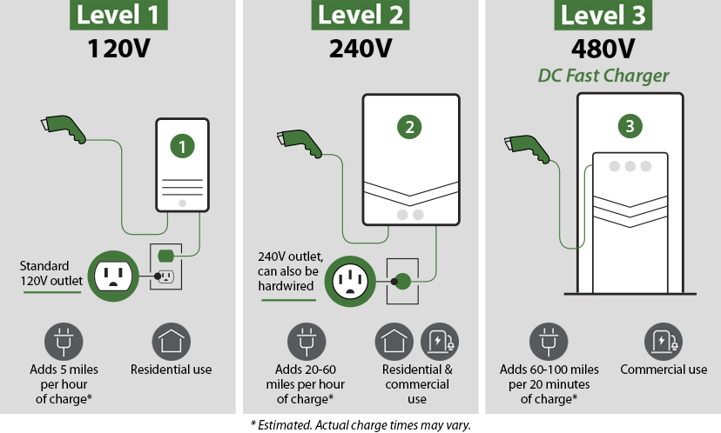
Three levels of EV charging
Level 1 Charging: Level 1 charging uses a common 120-volt household outlet.
Level 2 charging: [208V-360V] Level 2 charging is the most commonly used level for daily EV charging.
Level 3 charging : [400V-900V]{DC Fast Charging} Level 3 charging is the fastest type of charging available Level 3 charging uses direct current (DC)

Slide 9
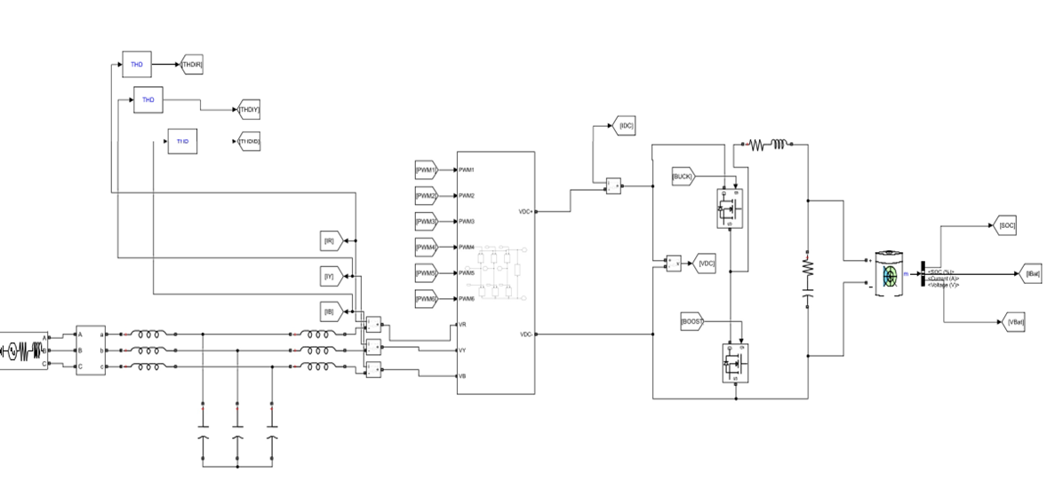
Simulation Scheme

Slide 10
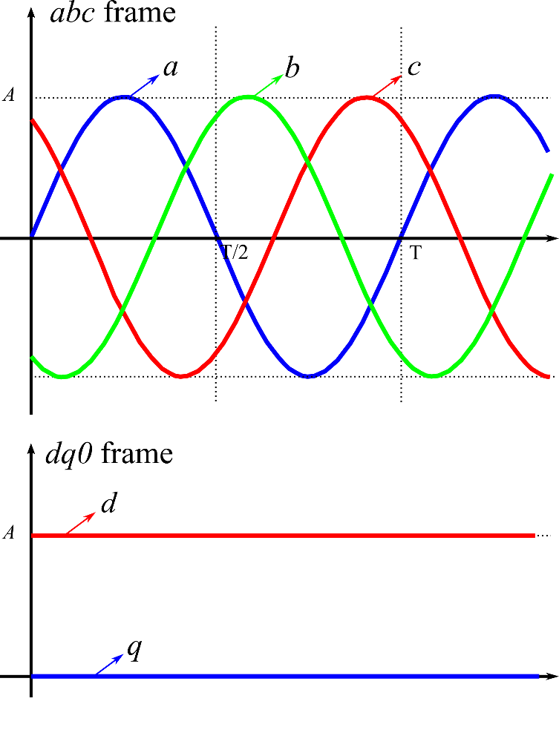
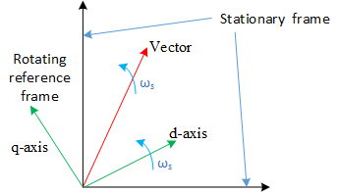
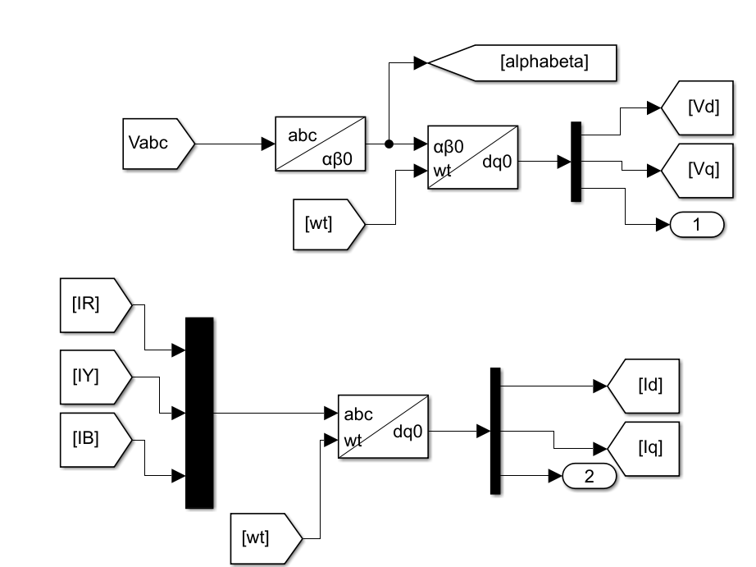
Synchronous Reference Frame (SRF) Theory
abc-alphabeta
alphabeta- dq

Slide 11
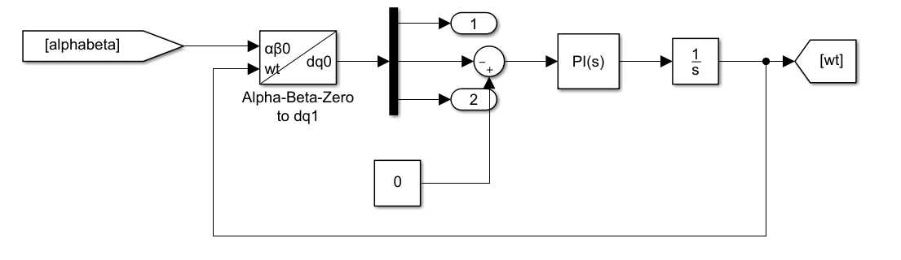
Phase Locked Loop

Slide 12
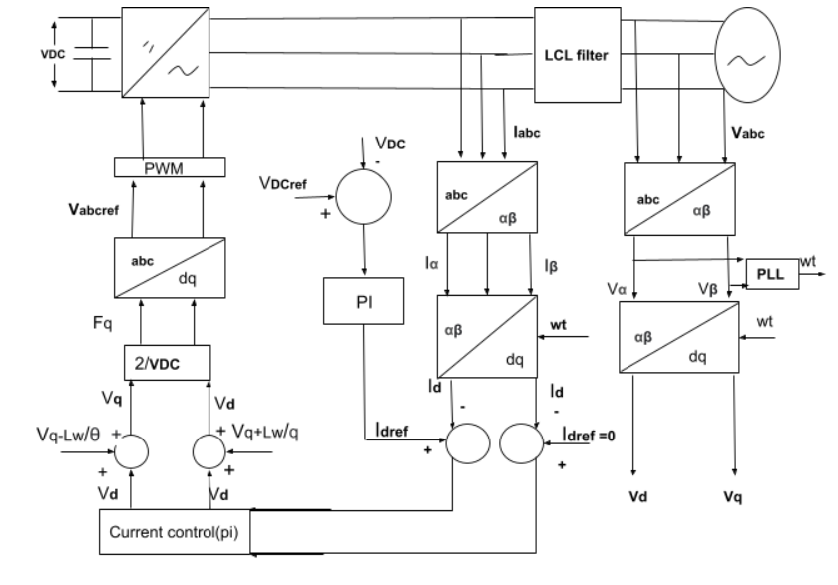
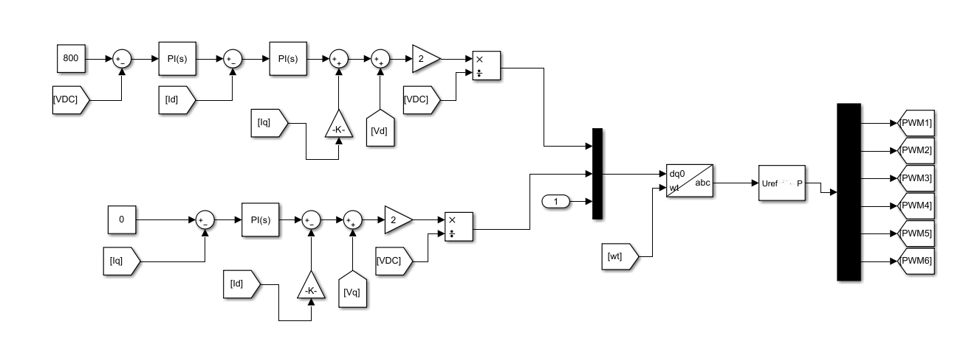
Control Mechanism Of Inverter

Slide 13
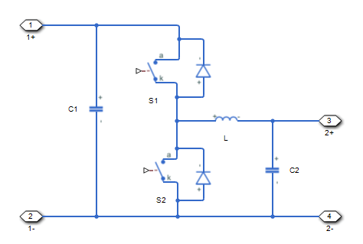
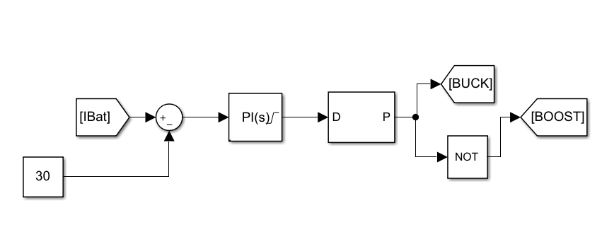
Control Of Bidirectional Converter

Slide 14
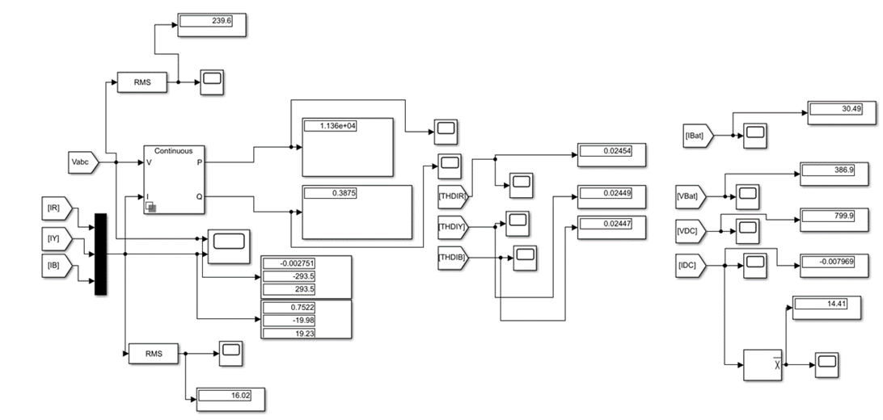
Results:
1. Battery Discharging (V2G)
Simulation result of battery discharging

Slide 15
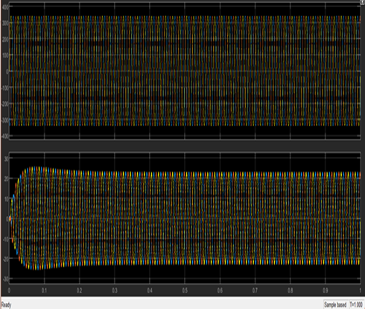
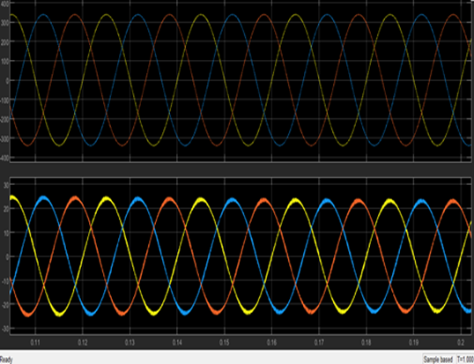
Grid Voltage and Grid Current

Slide 16
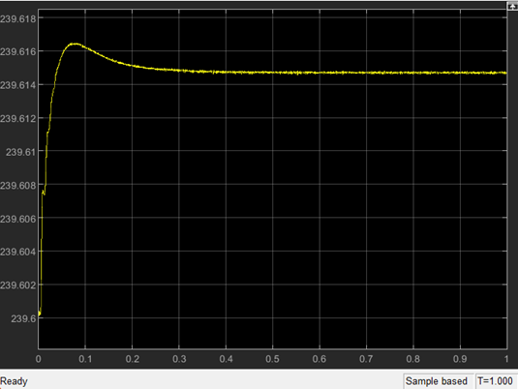
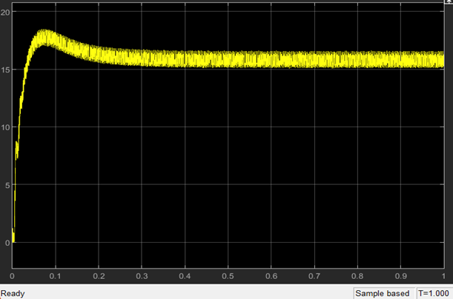
Vrms
Irms

Slide 17
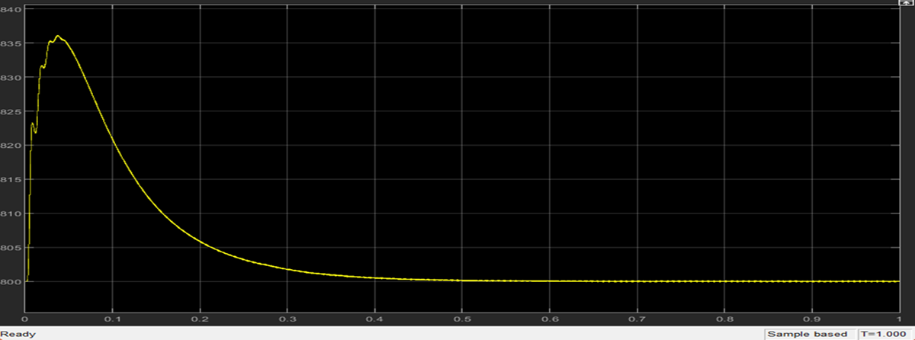
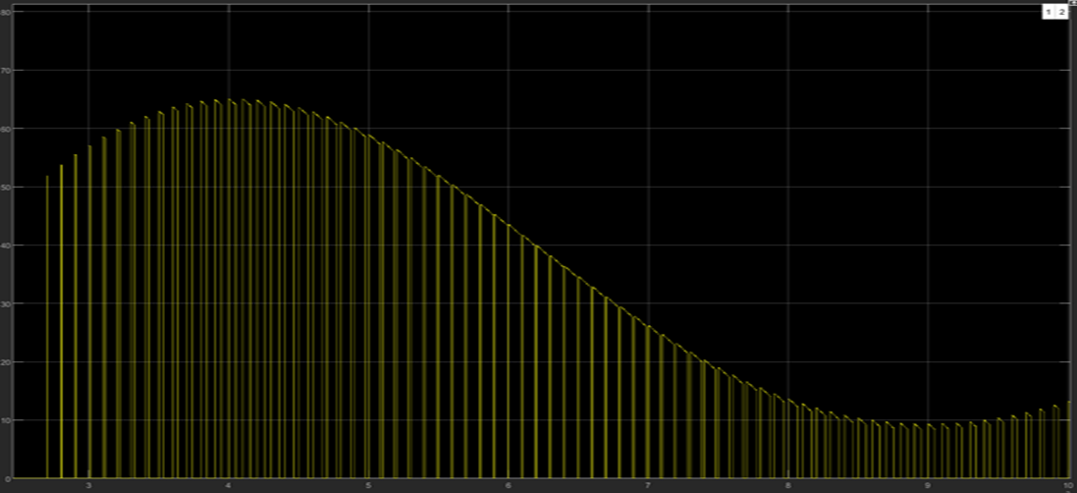
Vdc
Idc

Slide 18
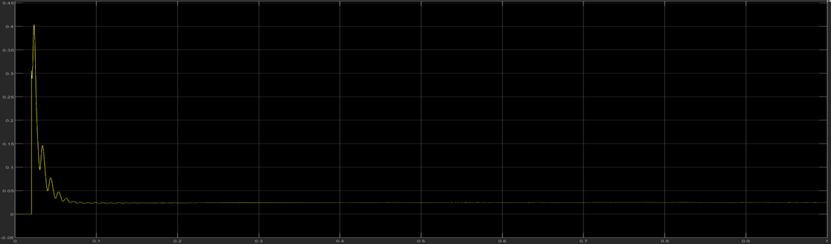
THD Ir

Slide 19
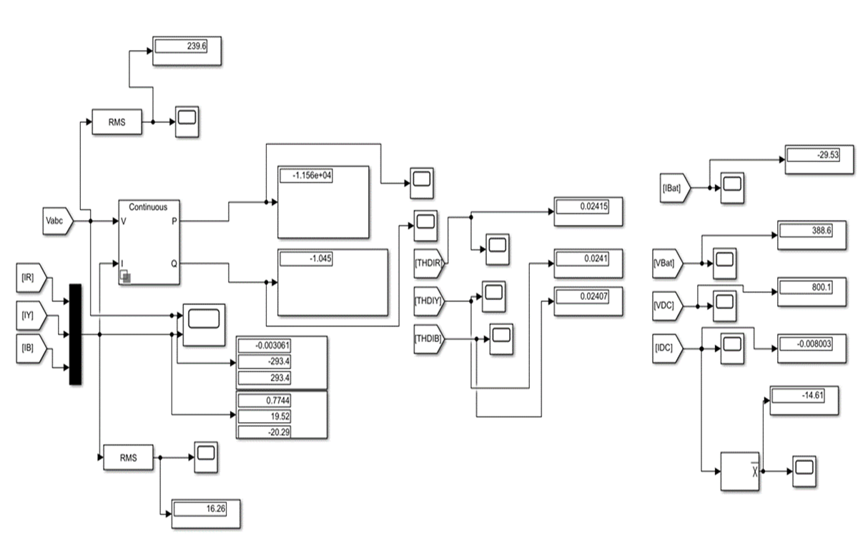
2. Battery Charging(G2V)
Simulation result of battery charging

Slide 20
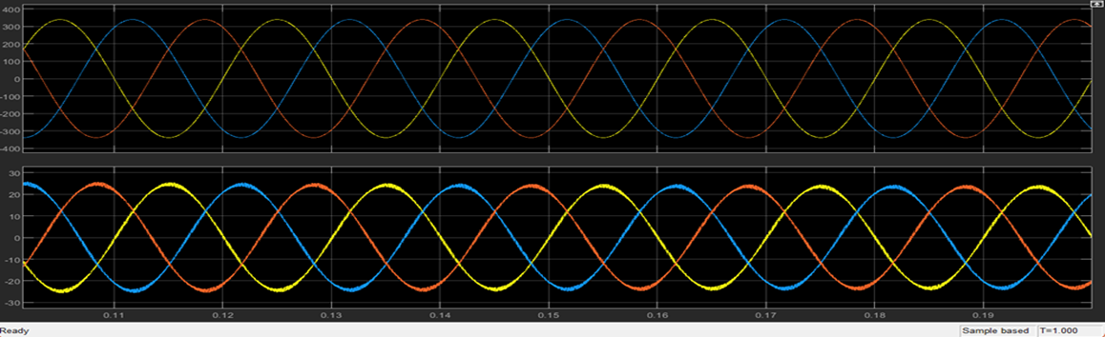
Grid Voltage and Grid Current

Slide 21
Future Work
MPC Controller
Fuzzy Logic

Slide 22
Conclusion
In this paper the bidirectional AC/DC and DC/DC converter was designed and simulated for electric vehicle charging stations. The result for vehicle to grid and grid to vehicle was successfully achieved. In this project the PI controller of voltage and current is also designed in order to get a quick steady state. It also produces less variation in output voltage. Also, the three phase AC/DC converter’s exact model was transformed to the synchronous d-q frame. Eventually the model was completed in MATLAB/Simulink. The result of experiment and simulation show the converter performs efficiently for both vehicle to grid and grid to vehicle application having low harmonics, low voltage ripple and low current THD. The output also verifies the active and reactive power in both the operation, with active power coming too high we are getting reactive power very low which is efficient to the work. This performance of the proposed bidirectional converter using proportional integral (PI) controller for the proposed operation that is vehicle to grid and grid to vehicle charging was then extensively investigated under the simulation study.

Slide 23
Reference
A. K. Karmaker, S. Roy and M. R. Ahmed, "Analysis of the Impact of Electric Vehicle Charging Station on Power Quality Issues," 2019 International Conference on Electrical, Computer and Communication Engineering (ECCE), Cox's Bazar, Bangladesh, pp. 1-6.2019.
A K Karmaker, MR Ahmed, MA Hossain, and MM Sikder. “Feasibility assessment &design of hybrid renewable energy based electric vehicle charging station in Bangladesh.” Sustainable Cities and Society 39: 189-202. 2018.
J. Wi, H. Kim, J. Yoo, H. Son, H. Kim and B. Kim, "Energy consumption of parallel type hybrid electric vehicle with continuously variable transmission using electric oil pump," 2018 Thirteenth International Conference on Ecological Vehicles and Renewable Energies (EVER), Monte-Carlo, pp. 1-7. 2018.
S. Habib, M. M. Khan, F. Abbas, L. Sang, M. U. Shahid, and H. Tang, “A comprehensive study of implemented international standards, technical challenges, impacts and prospects for electric vehicles,” IEEE Access, vol. 6, pp. 13866–13890, 2018. View at: Publisher Site | Google Scholar
] S. Esther, S. K. Singh, A. K. Goswami et al., “Recent challenges in vehicle to grid integrated renewable energy system: a review,” in Proceedings of the 2018 Second International Conference on Intelligent Computing and Control Systems (ICICCS), pp. 427–435, Madurai, India, 2018. View at: Google Scholar
P. K. Joseph, E. Devaraj, and A. Gopal, “Overview of wireless charging and vehicle-to-grid integration of electric vehicles using renewable energy for sustainable transportation,” IET Power Electronics, vol. 12, no. 4, pp. 627–638, 2019. View at: Publisher Site | Google Scholar
M. A. Masrur, A. G. Skowronska, J. Hancock et al., “Military-based vehicle-to-grid and vehicle-to-vehicle microgrid-system Architecture and implementation,” IEEE Transactions on Transportation Electrification, vol. 4, no. 1, pp. 157–171, 2018.View at: Publisher Site | Google Scholar
B. Sah, P. Kumar, R. Rayudu, S. K. Bose, and K. P. Inala, “Impact of sampling in the operation of vehicle to grid and its mitigation,” IEEE Transactions on Industrial Informatics, vol. 15, no. 7, pp. 3923–3933, 2019.View at: Publisher Site | Google Scholar
T. Chen, X.-P. Zhang, J. Wang et al., “A review on electric vehicle charging infrastructure development in the UK,” Journal of Modern Power Systems and Clean Energy, vol. 8, no. 2, pp. 193–205, 2020. View at: Publisher Site | Google Scholar
S. I. Vagropoulos, G. A. Balaskas, and A. G. Bakirtzis, “An investigation of plug-in electric vehicle charging impact on power systems scheduling and energy costs,” IEEE Transactions on Power Systems, vol. 32, no. 3, pp. 1902–1912, 2017. View at: Publisher Site | Google Scholar

Slide 24
Continued…
A. Sridhar and A. R. Prabu, Bidirectional AC-DC Converter for Vehicle-To-Grid (V2G) Applications, Marquette University, Milwaukee, WI, USA, 2015.
S. Liu, D. Xin, and L. Yang, “A novel single-phase bidirectional electric-drive-reconstructed onboard converter for electric vehicles,” IEEE Access, vol. 8, pp. 44739–44747, 2020. View at: Publisher Site | Google Scholar
J. Zhang, H. Yan, N. Ding et al., “Electric vehicle charging network development characteristics and policy suggestions,” in Proceedings of the 2018 International Symposium on Computer, Consumer and Control (IS3C), pp. 469–472, Taichung, China, 2018. View at: Google Scholar
B. Koushki, P. Jain, and A. Bakhshai, “Topology and controller of an isolated bi-directional AC-DC converter for electric vehicle,” in Proceedings of the 2016 IEEE Energy Conversion Congress and Exposition (ECCE), pp. 1–8, Milwaukee, WI, USA, 2016. View at: Google Scholar
K. V. Sing, H. O. Bansal, and D. Singh, “A comprehensive review on hybrid electric vehicles: architectures and components,” Journal of Modern Transportation, vol. 27, no. 2, pp. 77–107, 2019.View at: Google Scholar
P. Yang, T. Peng, H. Wang et al., “A single-phase current-source bidirectional converter for V2G application,” in Proceedings of the 2017 IEEE 3rd International Future Energy Electronics Conference and ECCE Asia (IFEEC 2017-ECCE Asia), pp. 704–709, Kaohsiung, Taiwan, 2017.View at: Google Scholar
B. Singh and R. Kushwaha, “A PFC based EV battery charger using a bridgeless isolated SEPIC converter,” IEEE Transactions on Industry Applications, vol. 56, no. 1, pp. 477–487, 2020.View at: Publisher Site | Google Scholar
A. K. Singh and M. K. Pathak, “Single-phase bidirectional ac/dc converter for plug-in electric vehicles with reduced conduction losses,” IET Power Electronics, vol. 11, no. 1, pp. 140–148, 2018.View at: Publisher Site | Google Scholar
B. Singh and R. Kushwaha, “A PFC based EV battery charger using a bridgeless isolated SEPIC converter,” IEEE Transactions on Industry Applications, vol. 56, no. 1, pp. 477–487, 2020.View at: Publisher Site | Google Scholar

Slide 25
Continued..
T.-L. Nguyen and H.-H. Lee, “An enhanced control strategy for AC-DC matrix converters under unbalanced grid voltage,” IEEE Transactions on Industrial Electronics, vol. 67, no. 3, pp. 1718–1727, 2020.View at: Publisher Site | Google Scholar
D. Mishra, B. Singh, and B. K. Panigrahi, “Adaptive current control for a Bi-directional interleaved EV charger with disturbance rejection,” in Proceedings of the 2020 IEEE International Conference on Power Electronics, pp. 1–6, Smart Grid and Renewable Energy (PESGRE2020), Cochin, India, 2020.View at: Google Scholar[22] J. Zhao and Q. Jiang, “Research on a new control strategy for three-phase current-source PWM rectifier,” in Proceedings of the 2017 Eighth International Conference on Intelligent Control and Information Processing (ICICIP), pp. 157–161, Hangzhou, China, 2017. View at: Google Scholar
O. Noureldeen, I. Hamdan, and B. Hassanin, “Design of advanced artificial intelligence protection technique based on low voltage ride-through grid code for large-scale wind farm generators: a case study in Egypt,” SN Applied Sciences, vol. 1, no. 6, pp. 1–19, 2019.View at: Publisher Site | Google Scholar
O. Noureldeen and I. Hamdan, “Design of robust intelligent protection technique for large-scale grid-connected wind farm,” Protection and Control of Modern Power Systems, vol. 3, no. 1, pp. 1–13, 2018.View at: Publisher Site | Google Scholar
K. Qian, G. Gao, and Z. Sheng, “A maximum current control method for three-phase PWM rectifier for the ITER in-vessel vertical stability coil power supply,” IEEE Transactions on Plasma Science, vol. 46, no. 5, pp. 1689–1693, 2018. View at: Publisher Site | Google Scholar
W. Li, X. Ruan, D. Pan, and X. Wang, “Full-feedforward schemes of grid voltages for a three-phase $LCL$-Type grid-connected inverter,” IEEE Transactions on Industrial Electronics, vol. 60, no. 6, pp. 2237–2250, 2013.View at: Publisher Site | Google Scholar
Wikimedia Foundation. (2022, June 11). Hybrid Electric Vehicle. Wikipedia. Retrieved June 15, 2022, from https://en.m.wikipedia.org/wiki/Hybrid_electric_vehicle

Slide 26
Thank you

